Slide 1
Playing and learning from the past Kickoff Meeting, 05-06 July 2022, Trikala, Greece

Slide 2
Main project details
Duration: 24 months
Starting date : 28/02/2022
Ending date: 27/02/2024

Slide 3
Transnational Project Meetings
Kick-off meeting. June 2022 at the premises of the coordinator Directorate of Primary Education of Trikala (Greece) and which will be attended by 2 representatives from each partner
Second Meeting. It will take place in October 2022 at the premises of CRHACK LAB FOLIGNO 4D ODV (Italy) and which will be attended by 2 representatives from each partner
Third Corporate Meeting. It will take place in May at the premises of ISTANBUL VALILIGI (Turkey) and which will be attended by 2 representatives from each partner
Final meeting. It will take place in January 2024 at the premises of the Inspectoratul scolar judetean Iasi (Romania) and which will be attended by two (2) representatives from each partner

Slide 4
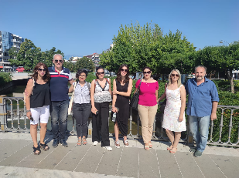
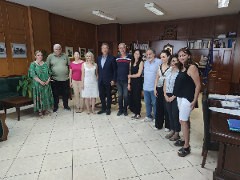
Kickoff Meeting “Playing and learning from the past”
05-06 July 2022, Trikala, Greece
Participant:
Ilie Eliza – school inspector for History at ISJI
Giorgia Marchionni - Crhack Lab Foligno 4D
Silvia Fratini - Crhack Lab Foligno 4D
Fatma Eroğlan- Governorship of Istanbul
Hristos Trikalis - DIRECTORATE OF PRIMARY EDUCATION OF THESSALY
Achilles Kostoulas - DEVELOPMENT CENTER OF THESSALY

Slide 5
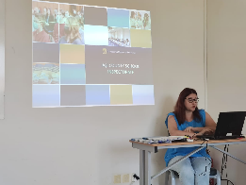
Training on the use of the intellectual products of this project by educators of primary education
During the programme, each organisation presented the profile and work of their organisation and, in the context of the exchange of best practices, further details on the implementation of the programme were discussed. The programme was implemented in the premises of AKETH.

Slide 6
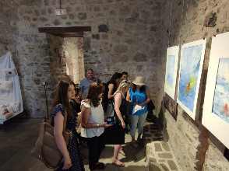
Practical examples of the use of games by using an already highlighted application with reference to the city of Trikala.
The following sights were visited: Osman shah Mosque & Hamam as well as the Old Town & Castle of Trikala and with the help of the app https://en.actionbound.com/ information, photos, a virtual tour of the sights were accessed to complement the on-site visit.
The information in the app was tailored to the age specifics of the students and was interactive. The app was complemented with a form of evaluation and reflection through quiz questions with the role of reinforcing the experience gained during the visit.

Slide 7
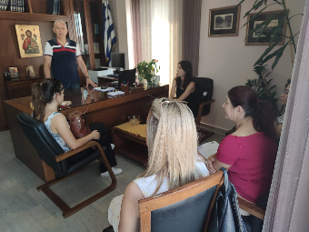
Training on the use of the intellectual products of this project by educators of primary education.
Content:
The advantages of using the games for affective engagement, behaviorist engagement, cognitive engagement, social and cultural engagement
Gamification
The Prenski model
Teaching scenarios – good practices about using the games play learning
Useful resources

Slide 8
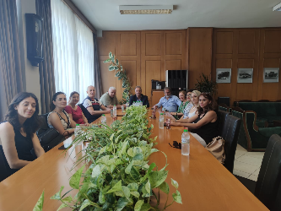
The partners visited the offices of the Directorate of Primary Education in Trikala and were informed about the functioning of the Directorate and the schools belonging to it.
They also visited the regional unit in Trikala, where they were welcomed by the deputy regional governor, Mr. Christos Michalakis, while Mr. Bardas and Mr. Boutinas were also present at the meeting.
The guided tours of Trikala were particularly interesting and the participants cultivated friendships and laid the foundations for the second mobility, which will take place in Italy in October 2022.

Slide 9
Tasks and responsibilities of each partner organisation
Directorate of Primary Education of Trikala (with co-leader Inspectoratul scolar judetean Iasi) is responsible for the first intellectual product O1- Game-based learning integration guide
CRHACK LAB FOLIGNO 4D ODV (with co-leader ISTANBUL VALILIGI) is responsible for the second intellectual product O2 -Application for mobile devices of a digital platform for browsing and presenting information of cultural points of interest
The Development Center of Thessaly is responsible for the third intellectual product O3- Interactive educational games for elementary school children

Slide 10
Tasks and responsibilities of each partner organisation
The partner Inspectoratul scolar judetean Iasi has been appointed responsible for the internal monitoring and evaluation procedures of the project, which are described in the corresponding field of the proposal
The partner ISTANBUL VALILIGI, was appointed responsible (leader) for the dissemination of the results and deliverables of the project based on the detailed plan as described in the respective field of the proposal

Slide 11
Project Result 1
A guide of integrating game-based learning
Result Leading Organization: DIEYTHINSI PROTOVATHMIA EKPAIDEYSIS TRIKALON (PRIMARY EDUCATION DIRECTORATE OF TRIKALA)
The guide will include ready-made examples for implementing game-based learning scenarios, a step-by-step guide to implementing and integrating game-based learning in the classroom, charts, infographics, ready-to-use digital educational content, good practices, case studies, etc. The ultimate goal of this guide is to provide all the necessary tools for teachers so that they know how to design, use, and integrate game-based learning into their classroom.

Slide 12
Project Result 2
Application for mobile devices on a digital platform for browsing and presenting information of cultural interest
Result Leading Organization: CRHACK LAB FOLIGNO 4D ODV
An application for the dissemination of cultural heritage information should take care of both types of users (mobile and fixed), making the most of the features of each access device (mobile versus desktop). The design of the application includes additional innovative features, such as the provision of personalized suggestions for activities that are considered appropriate for the user.
An additional feature provided is the use of augmented reality techniques, through which digital graphics, sound and stimuli for the other senses are superimposed on a real environment, providing a "live" and interesting experience for users.

Slide 13
Project Result 3
Interactive educational game for primary school students
Result Leading Organization: ANAPTIXIAKO KENTRO THESSALIAS
This involves the creation of digital educational games (one for each partner country) based on game-based learning which aim simultaneously to the improvement of literacy principles and contribute to the support and development of the emerging cultural and digital literacy of the learners utilizing the cultural identity of each partner country with the use of internet applications.
The produced games will comprise a basic educational tool not only in the hands of primary school educators but also of the learners and their guardians. The main educational aim of this intellectual product is the connection of the learners with the history and culture of their region deploying modern technology, in order to understand technology as a mean of approaching multiple fields of research.

Slide 14
Multiplier Events
Event Title: Seminar on the use of interactive educational games in primary education
These events aiming at the presentation of the project and its completed results in the countries of the partners. The event will take place in February 2024. The three intellectual outputs (results) of the project will be presented to the wide audience of interest: the guide for game based learning (O1), the application of a digital search platform in places of cultural interest (O2) and the interactive educational game for primary school students with the use of augmented reality(O3).
During the seminar lecturers, educators, and representatives from educational and cultural organizations will be invited in order to share their personal experiences on modern technologies applications in combination with promoting cultural elements.

Slide 15
Learning, Teaching, Training Activities
Title: Training on the use of the intellectual products of this project by educators of primary education
The training activities will be implemented by the DEVELOPMENT CENTER OF THESSALY in collaboration with the DIRECTORATE OF PRIMARY EDUCATION OF THESSALY on November 2023 in Trikala Thessaly.
The process of training includes three intellectual products of the project. The guide for game based learning (IO1), the application for mobile devices of digital search platform and presentation of information about places of cultural interest (O2) and the interactive educational game for primary school students(O3).

